Slide 1
Introduction to Corporate Finance
Corporate Finance and Financial manager;
Financial manager’s responsibilities;
Managerial actions to maximize shareholder wealth;
Corporate finance and other functional areas;
The agency problem:
Stockholders versus managers and
Stockholders versus creditors;
Ethics in financial decisions;
Corporate governance and
Corporate social responsibilities.

Slide 2
Concept of Corporate Finance
Corporate finance: The management of financial resources of business entity Finance
For example: If one big project is to be estimated, what sort of financial decision might be involved:
Public (management of funds of government)
Private (Personal)
(Funds of individual)
Business (decision making on managerial decision, investment decision and asset management decision

Slide 3
Continue…
1st : Estimate cost and benefit and make capital expenditure decision / investment decision
2nd : Manage funds for expenditure ( financing decision)
3rd: Management of acquired assets (Assets management decision
Financial management is concerned not only with the financing decision but also with investment and assets management decision as well as dividend decision

Slide 4
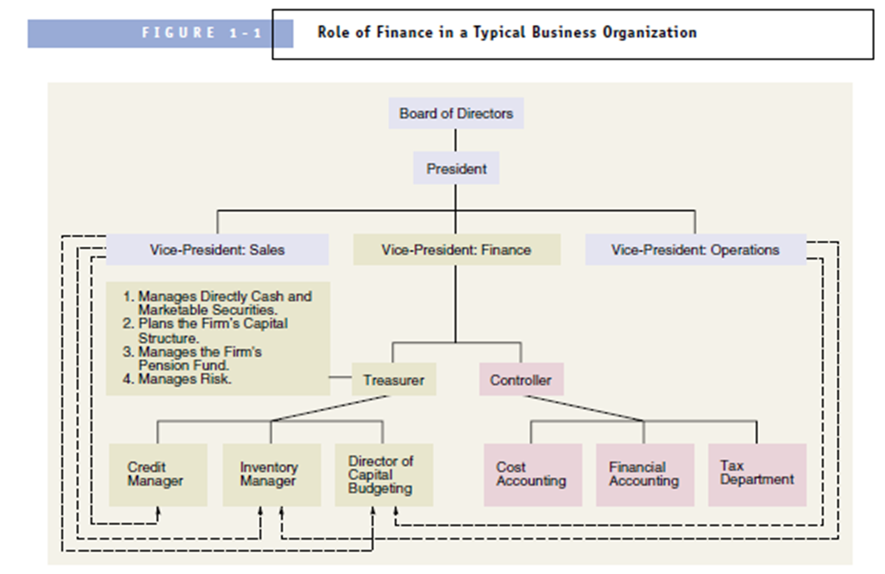
Corporate Finance and the Financial Manager
Financial managers refers to anyone responsible for investment and financing decision.

Slide 5
Financial Manager’s Responsibilities
Analysis of the financial aspects of all decisions
Analysis of Investment Decision
Analysis of Financing Decision
Analysis of Dividend Policy Decision
Analysis of Financial Condition of the firm
Analysis of Financial Markets
Analysis of Risk

Slide 6
Managerial actions to maximize shareholder wealth
Profit maximization Goal
Action that increase profit should be undertaken and those that decrease profit are to be avoided
Favor of Profit Maximization:
Profit is test of economic efficiency
Effective utilization of scare economic resources
Leads to total economic welfare
Criticism of Profit Maximization
Ambiguity (PAT or EBIT ; short term or long term, gross or net)
e.g issuing share and using proceeds in Treasury Bills can maximize profit but result decrease in EPS
Ignores Time value of money
Ignore Quality of Benefits
Unsuitable in Modern Business Environment (increase conflict among stakeholders

Slide 7
Managerial actions to maximize shareholder wealth
Wealth Maximization Goal
Managers should take decision that maximize the shareholder’s wealth
Project should generate positive Net Present Value (NPV = PV benefit – PV of cost)
Arguments in favor of wealth maximization:
Goal is clear (cost and benefit measured in terms of cash flow)
Consider Timing of cash flow
Consider quality of benefits (quality refers to certainty of cash flow)
Reduce conflict of Interest among stakeholders of firm. How
Allocate scare resources efficiently
Requires low cost business and high quality goods and services
Creditors must be paid before anything to be paid to stockholders
Employees are fairly compensated

Slide 8
Managerial actions to maximize shareholder wealth
Activities can be summed up in three principles:
Investment Principle
Financing Principle
Dividend Principle

Slide 9
Corporate Finance and Other Finance Areas
Relationship with Marketing Department
Relationship with Production Department
Relationship with Human Resource Department

Slide 10
Agency Relationship
Relationship between principal and agent
In financial management relationship between shareholders and managers can be viewed as principal and agent
Problem in the relationship is called as Agency Problem
Two Types of Agency Problem
Between shareholders and Managers
Between shareholders and Creditors/ Bond holders

Slide 11
Agency Problem: Between shareholders and Managers
Shareholders: passive principals
Managers: Active agents
Shareholders elect board of directors among themselves to manage firm in shareholders interest
In theory, managers agree with owners wealth maximization concept but in practice managers are concern with personal wealth, prestige, salary, job security, life style, fringe benefits.
Mechanism to resolve conflict:
Managerial compensation
Direct intervention by shareholder
Threat of firing
Threat of hostile takeover

Slide 12
Agency Problem: Between shareholders and Creditors
Arise when manager make decision for shareholders value maximization by ignoring the interest of creditors
Creditors are viewed as Principal and shareholders as agent
Creditors get priority for receiving their interest and principal repayment
Creditors oppose high risk as return is fixed so they do not want high risk in business
Mechanism to resolve conflict:
Compensate creditors for increased risk
Protective Terms and condition for creditors
Restrictive terms and condition may include:
restriction on purchase of share
restriction on restructure of capital structure
restriction on dividend policy decision

Slide 13
Business Ethics and Social Responsibility
Ethics: Moral principles that controls or influence a person’s behaviors
Business Ethics: also known as managerial ethics
Company’s attitude and conduct towards its employees, customers, community and stock holders
3 areas of concern of business ethics
How a corporation treats its employees
(Hiring and Firing, wages and Salaries, working condition and so on)
How employee treats the organization
(conflict of interest, secrecy, honesty)
How organization treats other stakeholders
(customers, competitors, suppliers, dealers and unions)

Slide 14
Social Responsibility
Implies that business should actively concerned with welfare of society at large.
Social Obstruction Approach
(do as little to solve social and environmental problems)
Social Obligation Approach
(do everything that is required by law but nothing more)
Social Response Approach
(meets social and ethical obligation and also goes beyond those requirement in selected cases)
Social Contribution Approach
(view as a citizen in a society and proactively seek opportunity to contribute)

Slide 15
Corporate Governance
Set of processes, customs, policies and laws that affects the way a company is directed, administered and controlled.
In finance : maximizing value of the corporation and shareholder wealth taking into account welfare of the corporate stakeholders
Good corporate governance balances individual and societal goals as well as economic and social goals.
Three generally accepted fundamental values of good governance:
Accountability (to shareholders)
Openness (transparency of risk assessment and decision making process)
Probity (strong moral principles; honesty and decency)

Slide 16
Questions for presentation
Define corporate finance in detail.
What is the role of financial manager in a corporation?
Why analysis of investing and financing decision are responsibilities of financial manager?
Why analysis of financial aspects and dividend decision are responsibilities of financial manager?
Why financial manager must analyze the financial markets and how he/she could reduce the associated risk?
Define wealth maximization principle. Also explain what sort of managerial actions are required to maximize the shareholder’s wealth.
How corporate finance is related to other department within an organization?
Why there exist agency problem between shareholders and managers and how conflict can be solved?
Why there exist agency problem between shareholders and creditors and how conflict can be solved?
Define business ethics and what are the areas of concern for business ethics?
Define corporate social responsibility and approaches of CSR.
Define corporate Governance and fundamental values of corporate governance.

Slide 17
Project Work
What sort of corporate social responsibility has been carried out by Nepalese Business Enterprises? Select any one company and mention.
Write about the corporate governance practices followed by any one of the Nepalese Business Enterprise.

